Slide 1

Problem Solving Session – khaled aldasouki
The remainder of today’s class will comprise the problem solving session (PSS).
Your instructor will divide you into teams of 3 or 4 students.
Each team will work together to solve the following problems over the course of 20-30 minutes.
You may work on paper, a white board, or digitally as determined by your instructor.
You will submit your solution by pushing it to GitHub before the end of class.
Your instructor will go over the solution before the end of class.
Write your name on each completed sheet.
Submit to the designated MyCourses’ Dropbox.
Class participation is a significant part of your grade (20%). This includes in class activities and the problem solving session.
Your graders will grade your participation by verifying that you pushed your solutions before the end of the class period each day.

Slide 2
Problem 1 – khaled aldasouki
Name: Khaled Aldasouki | Prior Experience (0-10): 5
Comments: -studied HTML for several months - has some experience in C++ and C# -studied game development with lua for a week
Software Development & Problem Solving is designed for students of all levels of experience. There are students in this classroom with little or no programming experience, students who have been coding for years, and every skill level in between.
Spend a few minutes talking with your team members about your prior experience with programming (in any language, not just Python).
Rate yourselves on a scale of 0 (very little or no experience) to 10 (you should be teaching this class!).
Fill out the tables with each of your answers.
Name: Abdullah Alrjoub | Prior Experience (0-10): 4
Comments: took 1 course of python in high school and another course of Java
Name: Mohammad Abdullah Majeed | Prior Experience (0-10): 1
Comments:
Name: Yara Nabhan | Prior Experience (0-10): 2
Comments:
Name: Osama Ismail | Prior Experience (0-10): 3
Comments:
If you are working digitally and need more space, duplicate this slide.

Slide 3

Problem 2 – khaled aldasouki
File
Dir
X:
Files in the file system are organized into a tree structure. Visualizing this structure can make finding files and directories more intuitive.
Assume that each of the following is an absolute path to a file in your file system. Draw the tree that represents the structure in the space on the left.
Your instructor will determine if you should work digitally, on paper, or on a whiteboard. Use the icons to the left as references.
Answer is drawn on the next slide
C:\Users\Ron\Documents\biography.txt
C:\Users\Ron\SoftDevI\Week01\homework.txt
C:\Users\Harry\todo_list.txt
C:\Program Files\Python\python.exe
C:\Program Files\Git\git.exe
D:\Games\WoW\wow.exe
D:\stuff.txt

Slide 4
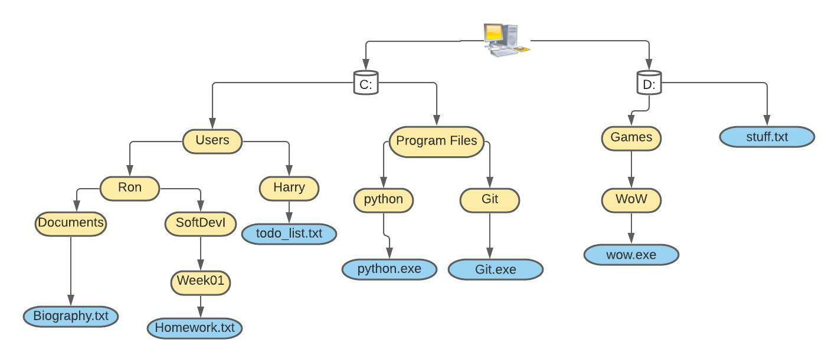
Problem 2 answer – khaled aldasouki

Slide 5
Problem 3 - khaled aldasouki
1. The file entered the working stage and is being edited, and may not end up in the final project yet. It is also not being tracked by github and is still located on the local drive.
2. The file has entered the staging stage and is now being tracked by github as it is most probably going to be a part of the final project, yet it is still on the local drive and has yet be pushed onto the remote repository
3. The file is being commited and is now considered a local copy, it is basically done and will be pushed once all the files it is related to are compelte and ready to be shared with the working team. The message being shared is “ adding a new file”
4. The file has been pushed into the remote repository and can now be cloned by the other contributers, and is now most probably not going to be edited anymore
5. The file is being changed again on the local repository, and is back into the staging area, as it is being tracked by github but remains different from the copy in the remote repositroy
Understanding the status of the files in your repository is important! Have you made changes to any files that need to be committed? What has been added, modified, deleted, or staged since your last commit?
Consider the following commands executed in a Git repository on your computer. Together with your team, describe the status of the file at each step.
notepad new_file.txt
git add new_file.txt
git commit -m "adding a new file"
git push
notepad new_file.txt (add text)

Slide 6
Problem 4- khaled aldasouki
1. To make sure that all the files are going to be part of the final project and not have any incomplete or useless files lying around
2. Clone or pull the files you are working on from github in order to assure the fact that you have the most updated version of these files. If you are starting a whole new project, then you should create a repository for this project to help organize and monitor your work over time, including the changes you make and the status of each file
3. Make sure to Save the files to avoid any losses
4. Assuming you have pushed the files you are working on onto the remote repository, you should clone (or pull) it onto the second computer and continue working from where you left off
Proper use of version control means understanding why we use it and not just memorizing how to use it.
Discuss the following questions with your team, and type or write your answers in the space on the right.
Why do you think that it is a good idea to check the status before staging files?
When starting a brand new assignment, what is the first thing you should do, and why?
What is the last thing that you should do before taking a break from working?
Assume that you are getting back to work on a different computer. What is the first thing you should do?

